Slide 1
A picture paints a thousand traits
Dani Welter, Functional Genomics Production Team
HSF Seminar 7 June 2012

Slide 2
Overview
Introduction to the GWAS catalogue
EBI/NHGRI project aims
Curation infrastructure
Ontology
GWAS diagram
Outlook

Slide 3
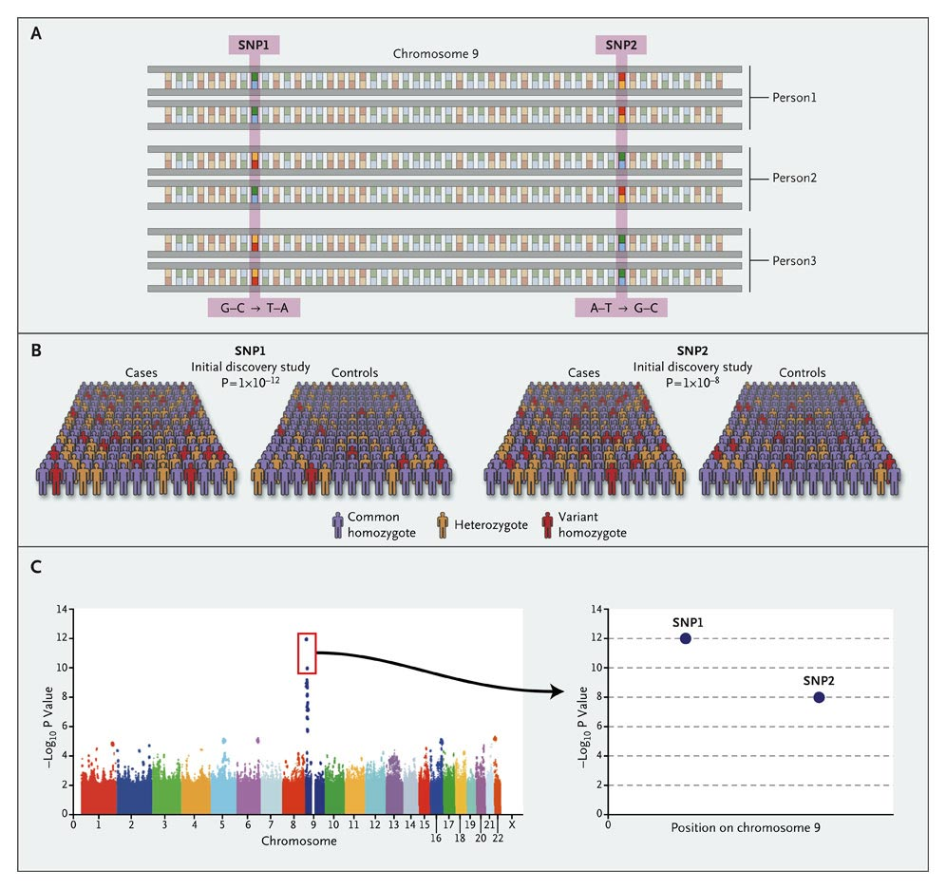
Genome-Wide Association Studies
Hundreds of thousands of SNPs tested for association with a trait or disease in large population samples
Insights include
New potential risk loci in or near genes not previously associated with a disease
New associations between traits or diseases not previously thought to have any common causes or share pathways
Additional information on chromosomal regions annotated as gene poor
Notes:
Potential involvement of the nervous system in obesity
JAZF1 associated with type 2 diabetes and prostate cancer
Complement-mediated inflammation (via complement factor H) in age-related macular degeneration

Slide 4

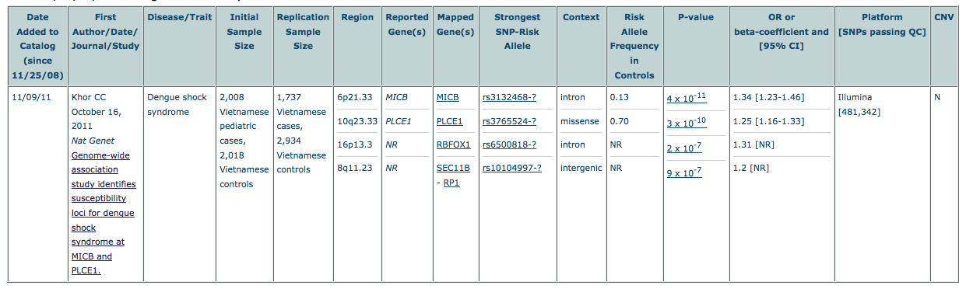
The NHGRI GWAS catalog
Manual curation of published GWAS studies
Weekly literature search to identify new studies
Manual data extraction into web interface
Data entry double-checked by 2nd-level curator
Quarterly GWAS diagrams
As of 25/05/12, the catalog includes 1269 publications and 6439 SNPs, with 655 distinct traits and nearly 8000 SNP-trait associations
http://www.genome.gov/gwastudies

Slide 5
EBI/NHGRI collaboration
2-year collaboration between the GWAS catalog team at the NHGRI and the Functional Genomics Productions (development) and Vertebrate Genomics (curation & display through Ensembl variation) teams at EBI
Arose from an MSc project by Paulo Silva (FGPT)
Aims
Manual visualisation
Automated visualisation
Unstructured data
Structured data
Static visual interface
Dynamic visual querying

Slide 6
Curation infrastructure
Development of tools to increase efficiency and accuracy of curation of data into the GWAS catalogue
Catalogue curation currently a labour intensive, entirely manual process
Development of an online tracking system to
Automatically perform Pubmed searches and enter papers into the system for review by curators
Assignment of papers to the appropriate curator for each stage of the curation process
Weekly literature search & eligibility
Data extraction
Data double-check
Genomic annotation (NCBI)
Publication to web
AUTOMATION

Slide 7
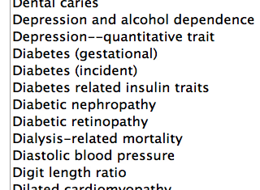
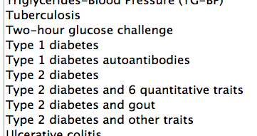
GWAS traits
GWAS catalogue traits previously only available as an unstructured list
Traits are highly diverse, including
Phenotypes, e.g. hair colour
Treatment responses, e.g. response to antineoplastic agents
Diseases, e.g. type 2 diabetes
Chemical/drug names, e.g. C-reactive protein
Traits are often compound and/or context-dependent
e.g. “Type 2 diabetes and gout” or “Parkinson’s disease (interaction with caffeine)”

Slide 8
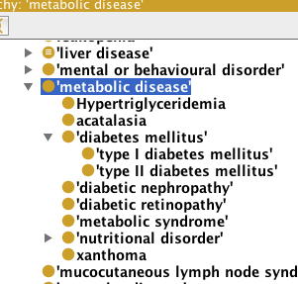
Ontology
Integration of traits into the structured hierarchy of an ontology, with additional semantically meaningful links between traits allows much more complex and extensive querying, e.g.
“Show me all SNPs associated with type 2 diabetes and metabolic syndrome”
Two options for ontology integration
Create new “GWAS ontology”
Integrate with an existing ontology

Slide 9



Integration with “Experimental Factor Ontology”
EFO is actively developed
Well-suited to covering diversity of GWAS traits
20% of GWAS traits already found in EFO prior to integration process
300 new terms added over 5 releases = 80% coverage
Very high integration potential
Other resources
http://www.ebi.ac.uk/efo/

Slide 10

New and more powerful queries
Knowledge base that imports all the GWAS catalogue data and EFO
More powerful queries
e.g. “Show me all SNPs associated with type 2 diabetes and metabolic syndrome, with a p-value of 10⁻⁵, from papers published before January 2010”
Increased integration potential
Facilitate visualisation
GWAS knowledge base
Other potential input sources

Slide 11
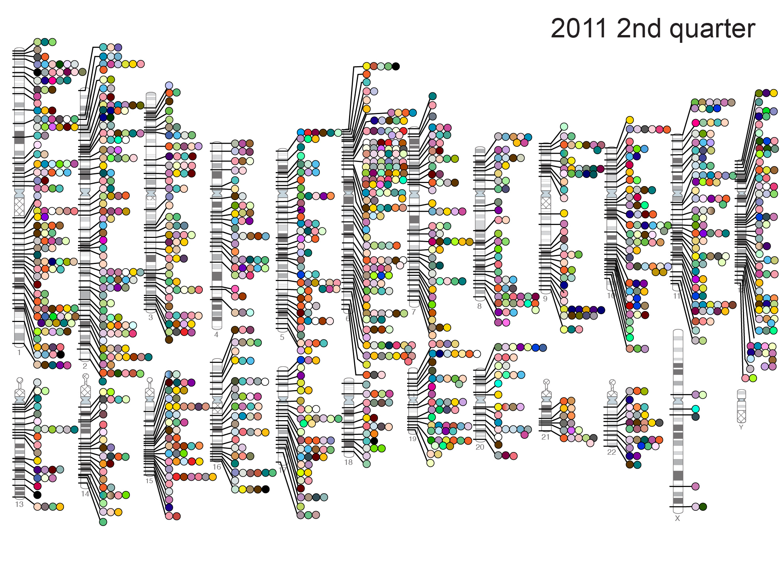
GWAS diagram
11

Slide 12
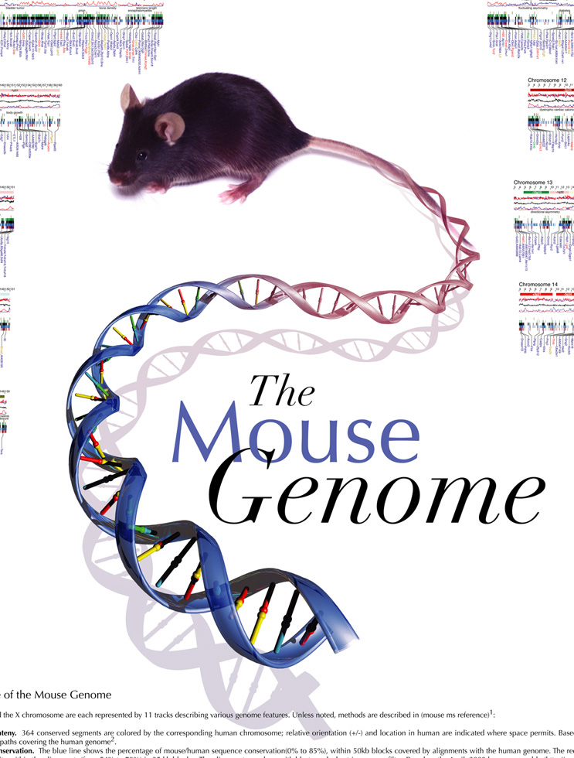

GWAS diagram
Visualisation of all SNP-trait associations with p-value < 10⁻⁸
Generated quarterly by a graphic artist following extensive manual curation of the data
Static image in PDF or Powerpoint format
Too many traits and colours to reliably identify any individual feature
Great way of visualising the evolution of the catalogue over time
http://www.genome.gov/multimedia/illustrations/GWAS_2011_2.pdf

Slide 13
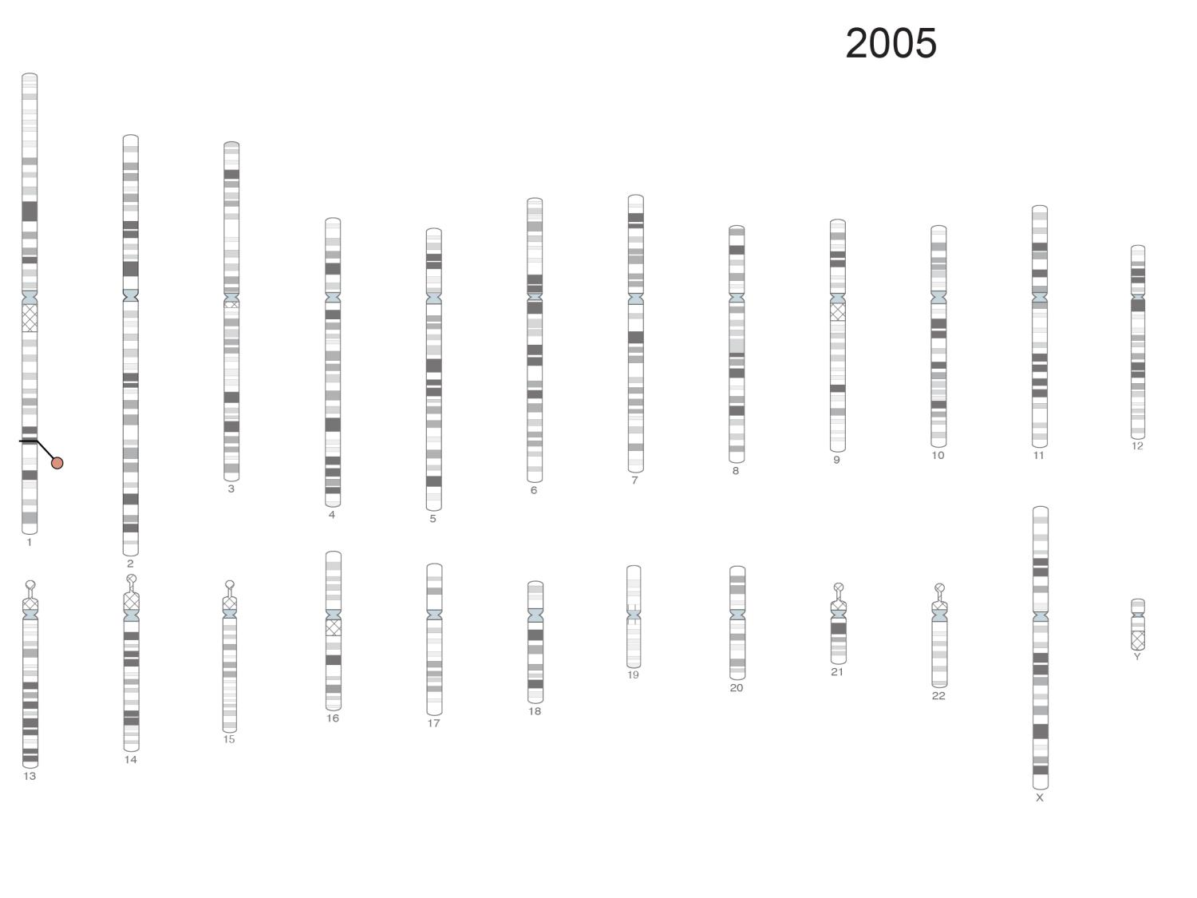
13
Notes:
13

Slide 14
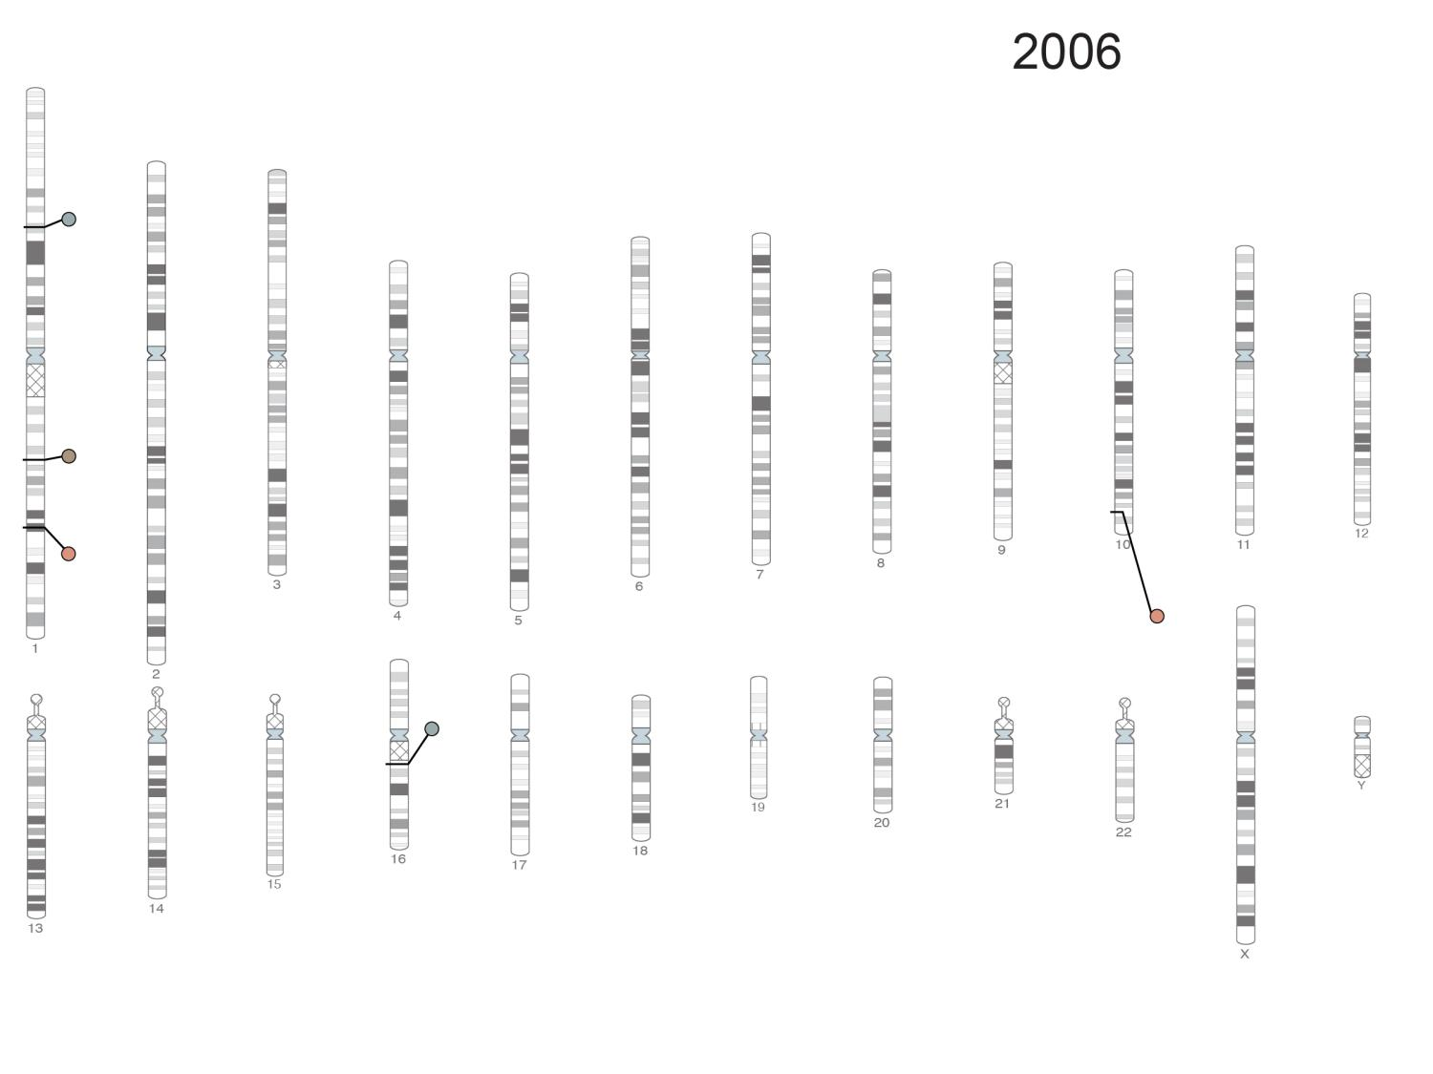
14

Slide 15
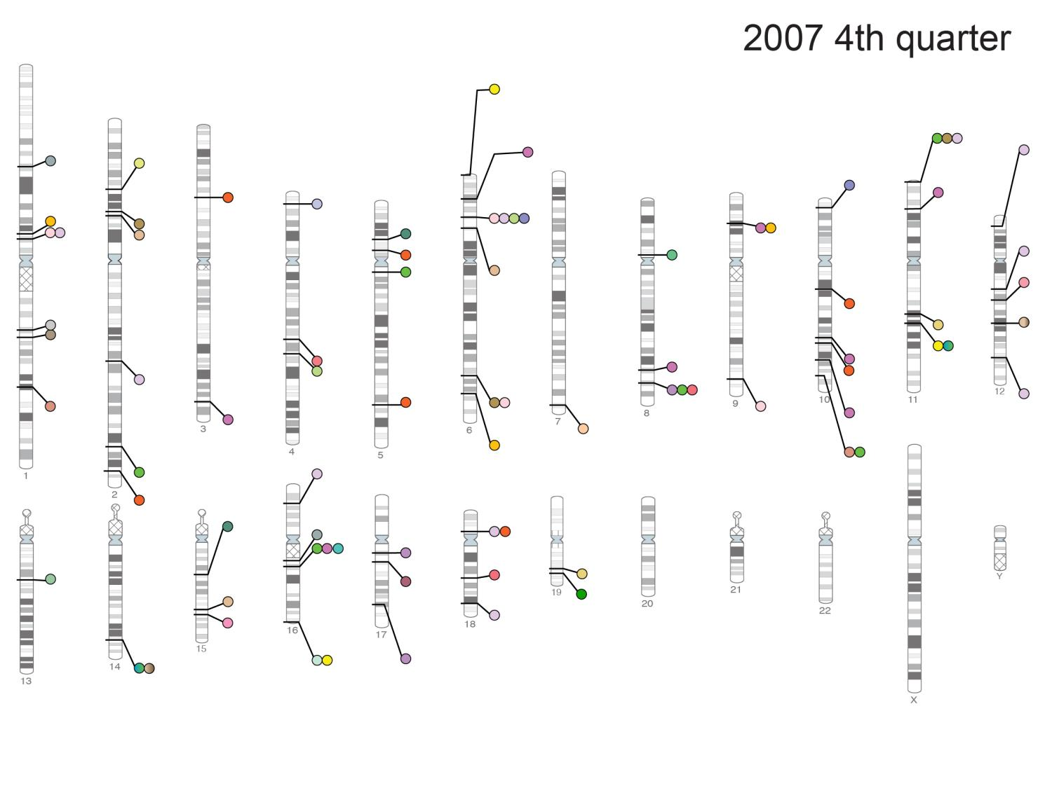
15

Slide 16
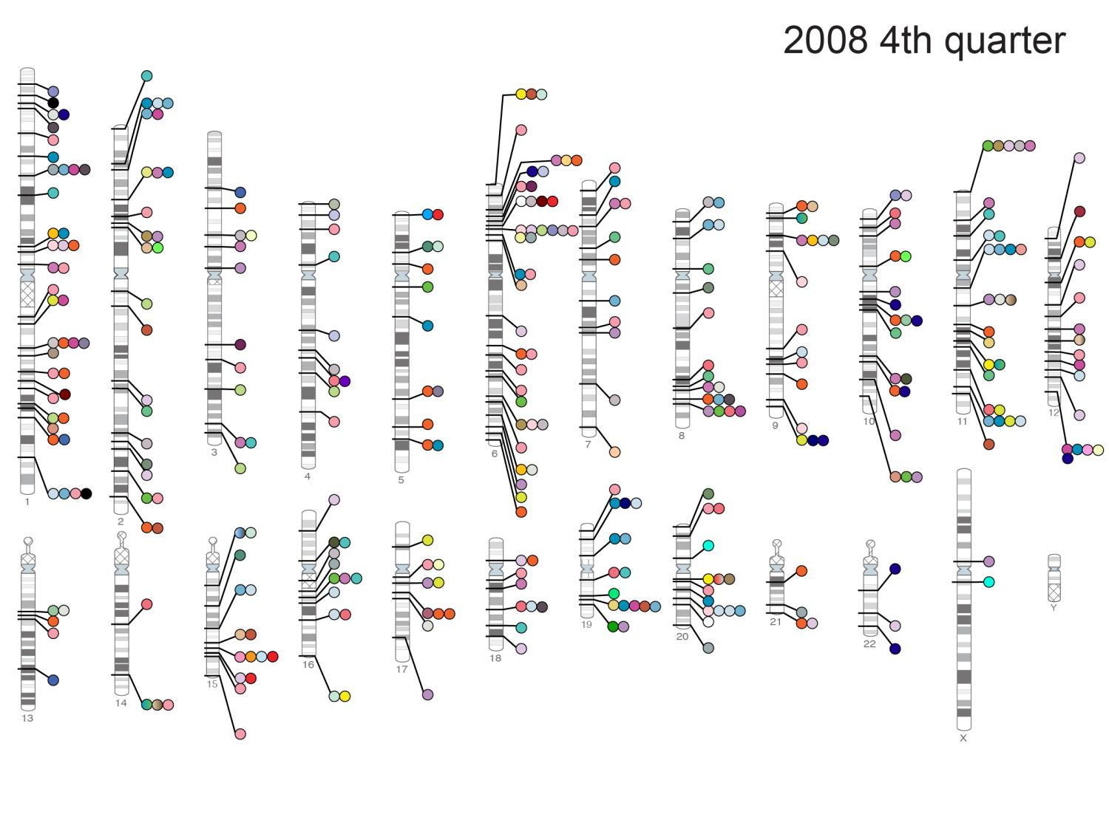
16

Slide 17
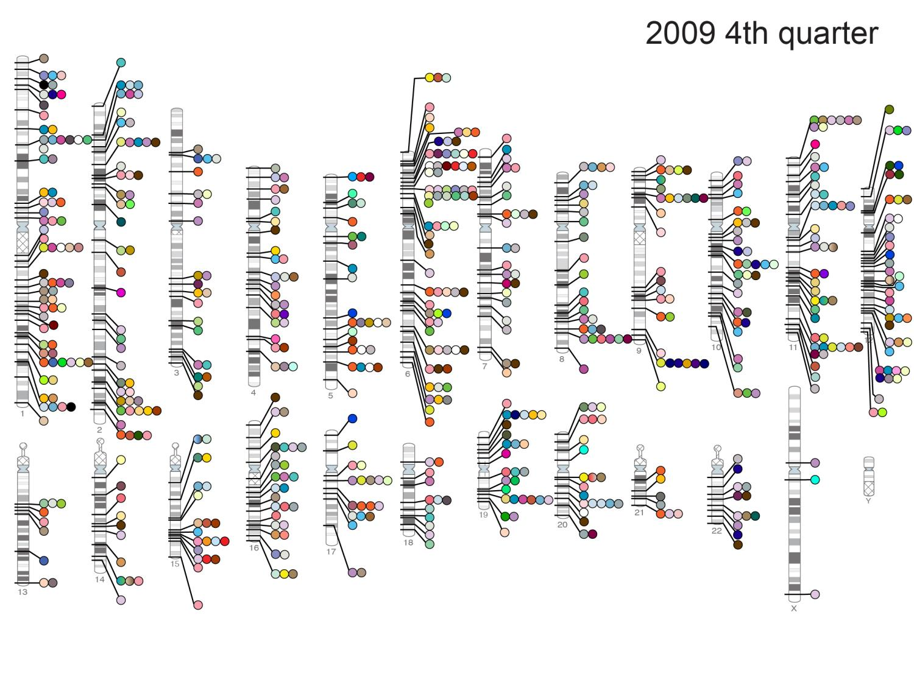
17

Slide 18
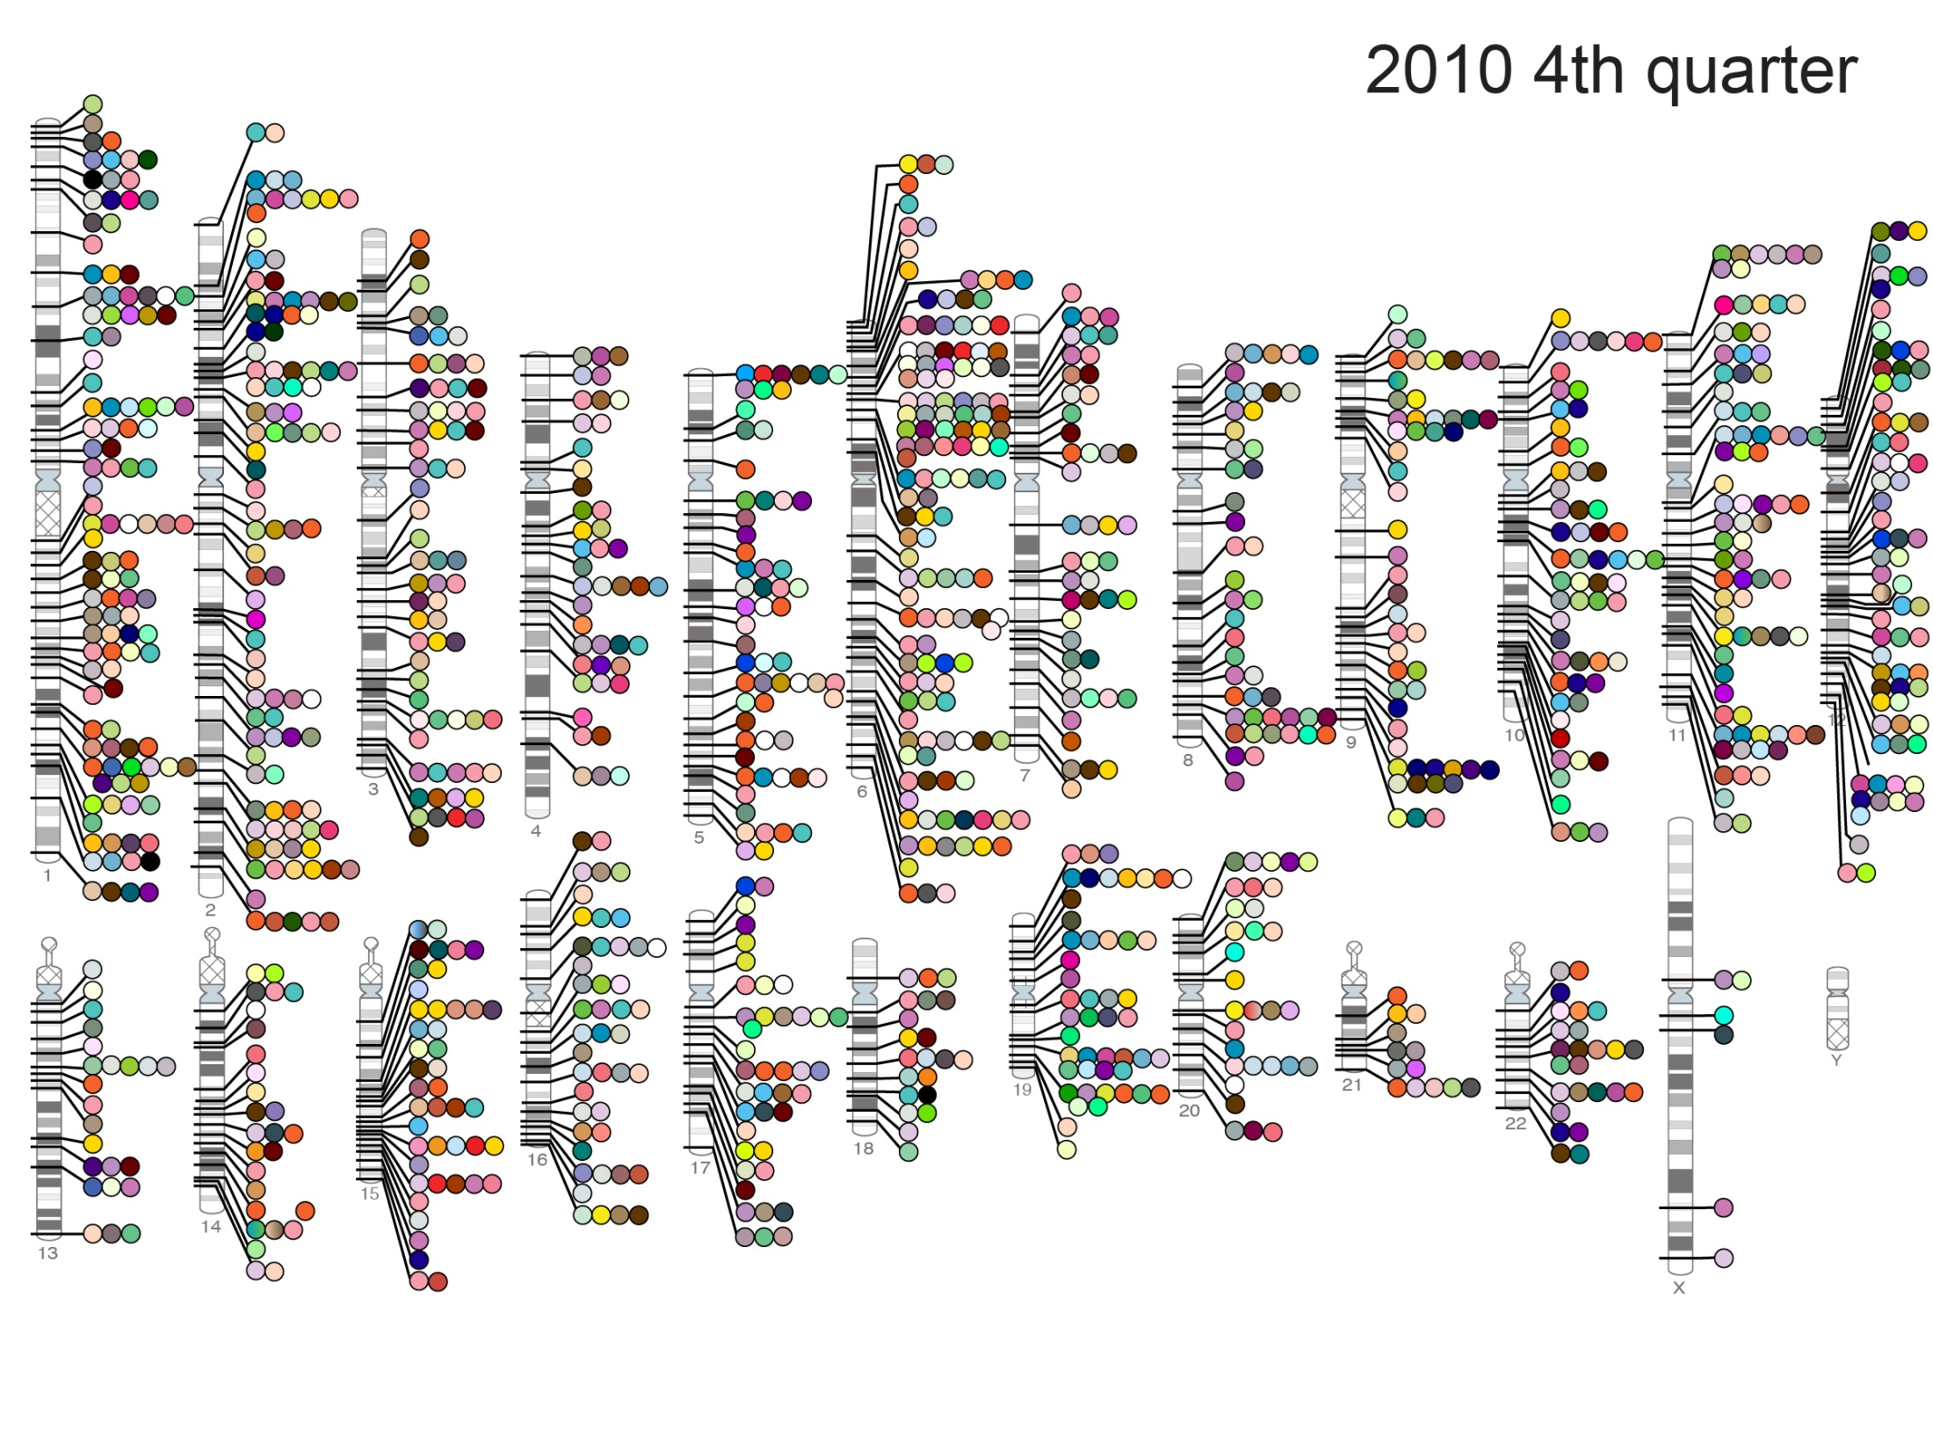
18

Slide 19
19

Slide 20
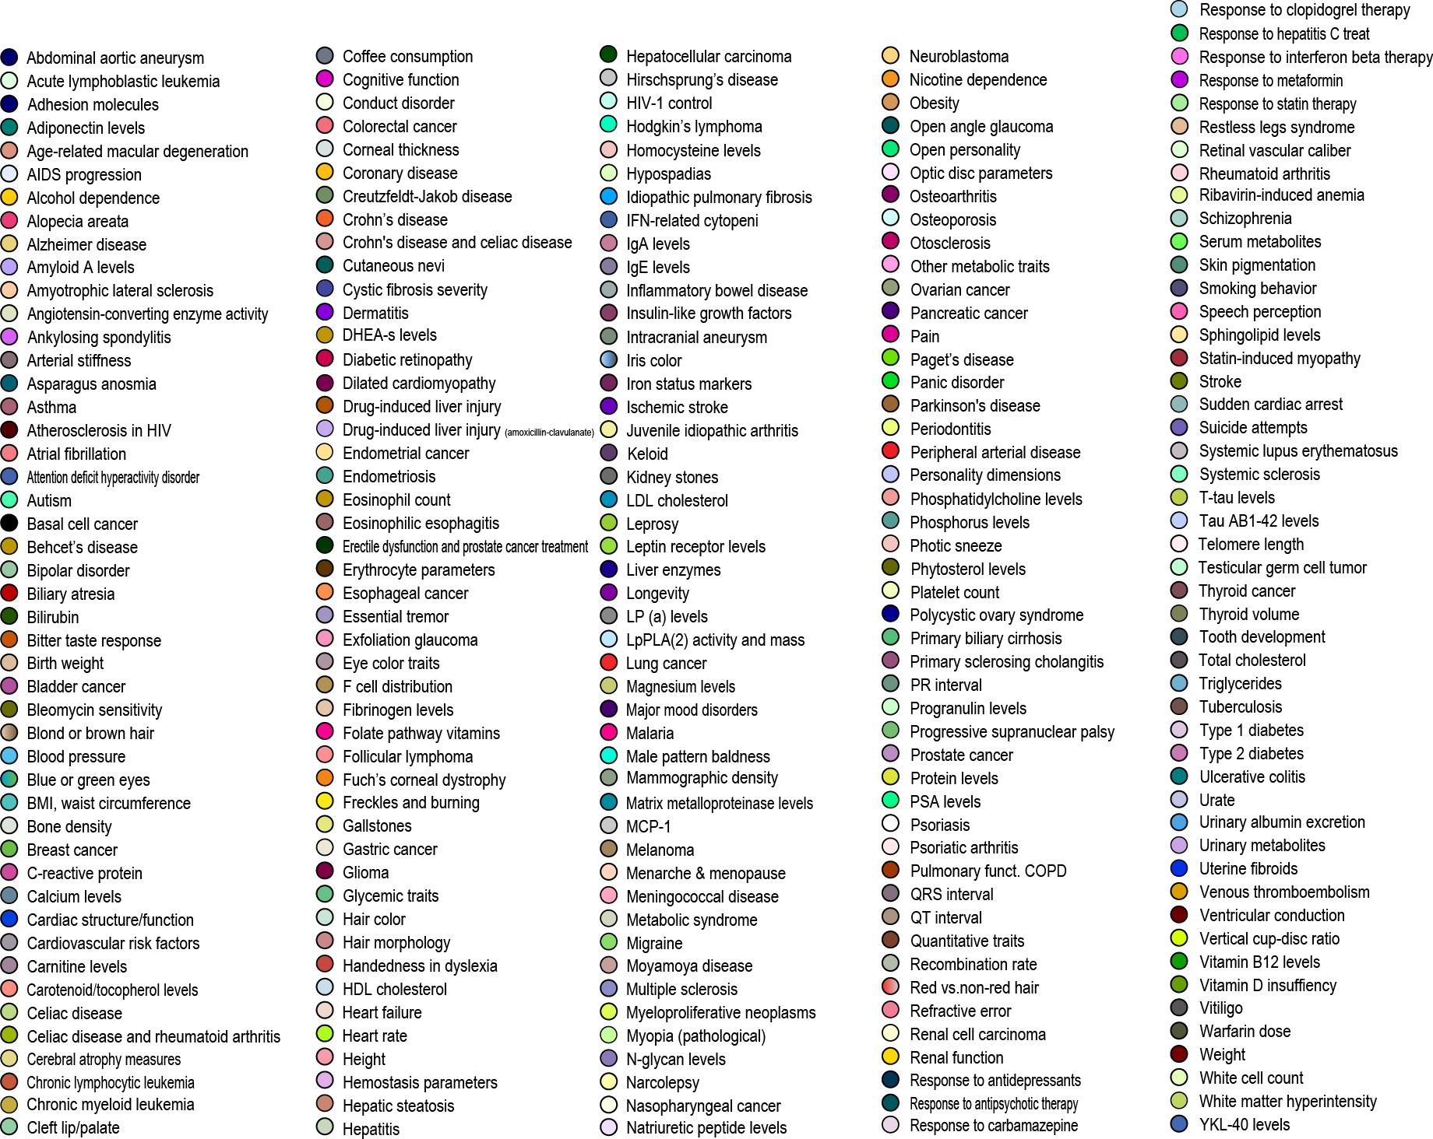
20

Slide 21
GWAS diagram automation
Programmatic generation of the GWAS diagram from the GWAS/EFO knowledgebase
Interactive diagram that can filtered by a number of criteria, e.g. to show only traits associated with a given disease
Interactive traits (“dots”) that link directly into the catalogue
New colour scheme with fewer colours representing higher-level trait categories, e.g. mental health disorders, cancers, cardio-vascular diseases

Slide 22
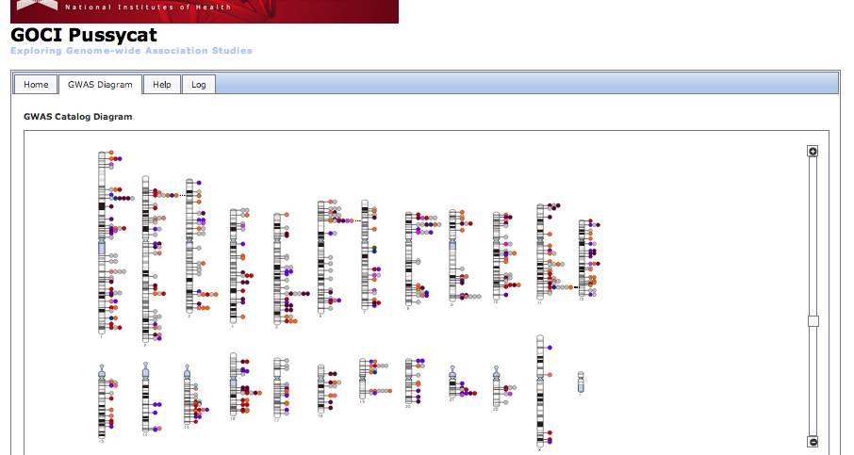
Now live! Fully automated diagram
wwwdev.ebi.ac.uk/fgpt/gwas/#

Slide 23
Current status
Manual visualisation
Automated visualisation
Unstructured data
Structured data
Static visual interface
Dynamic visual querying

Slide 24
Future work
Short-term goals
Finish integration of GWAS traits into EFO
Full first release, incl. basic filtering (trait & p-value), by September 2012
Long-term goals
Extensive querying
Explore different resolution strategies for high-density regions
Make GWAS diagram an entry point to the GWAS catalogue
Capture and model ethnicity information
Using mappings and ontology inside Ensembl

Slide 25
Summary
Restructured GWAS catalogue data to allow querying beyond direct string matching
Remapped catalogue data for easier integration with other data sources
Removed manual processing from catalogue visualisation
Used semantic web technologies for querying and visualisation of catalogue data, with excellent results!

Slide 26
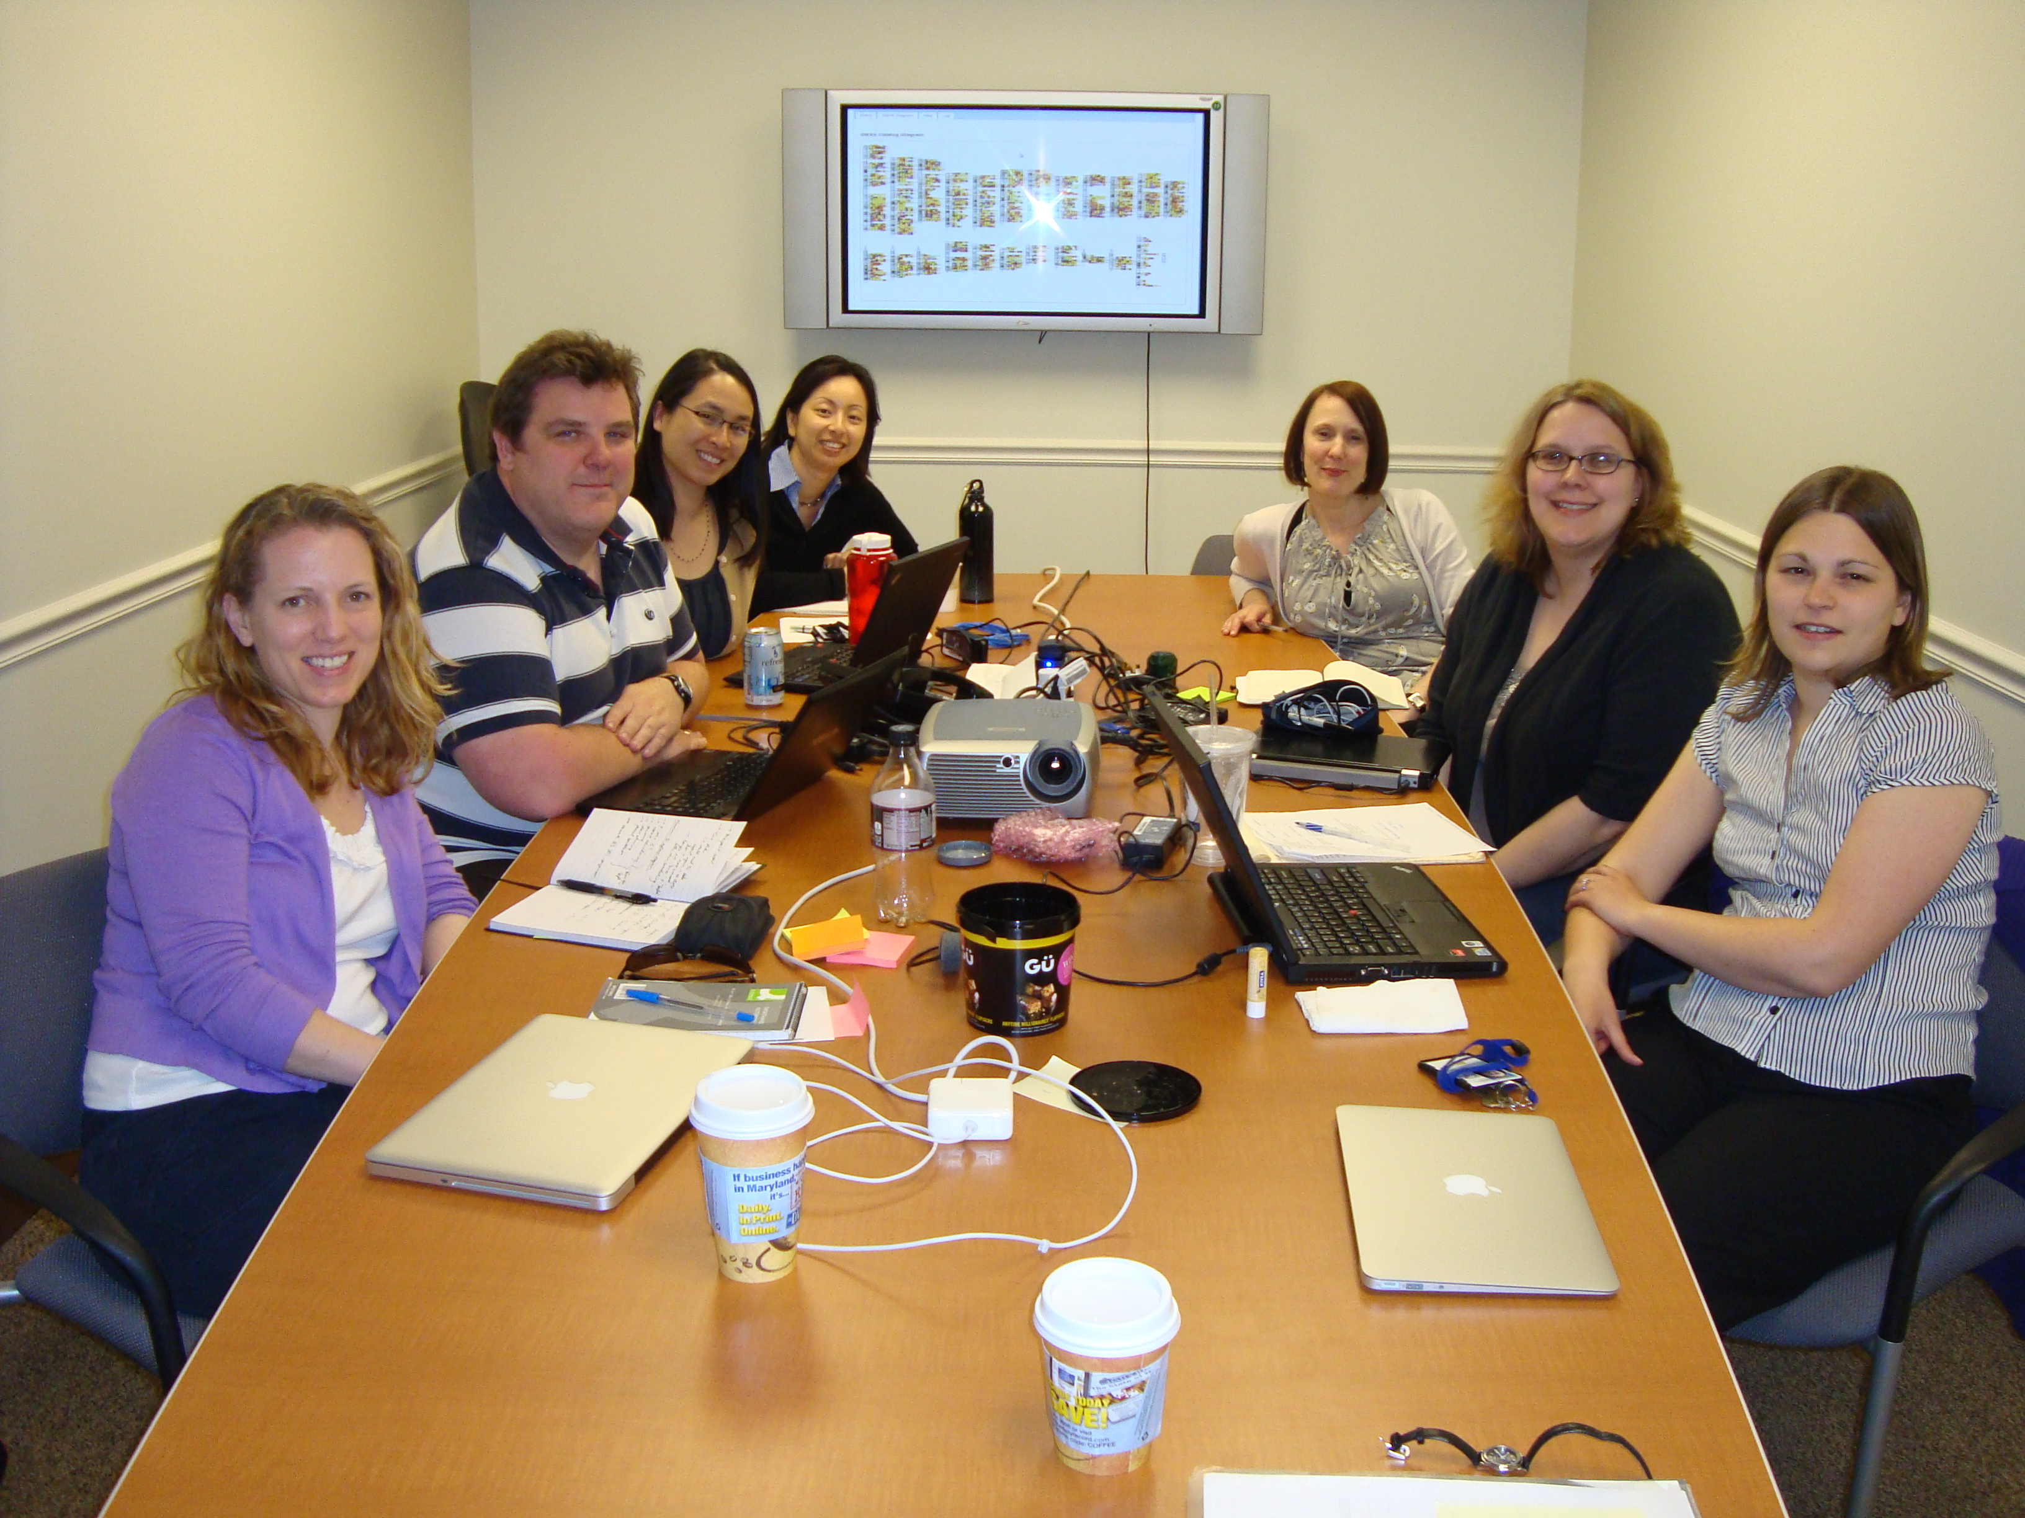
Acknowledgements
NHGRI
Peggy Hall
Lucia Hindorff
Heather Junkins
Kent Klemm
Darryl Leja
Teri Manolio
EBI
Tony Burdett
Jon Ison
Simon Jupp
James Malone
Jackie MacArthur
Dani Welter
Fiona Cunningham
Paul Flicek
Helen Parkinson
Funding:
NHGRI grant 3U41-HG006104-01S1

